Slide 1
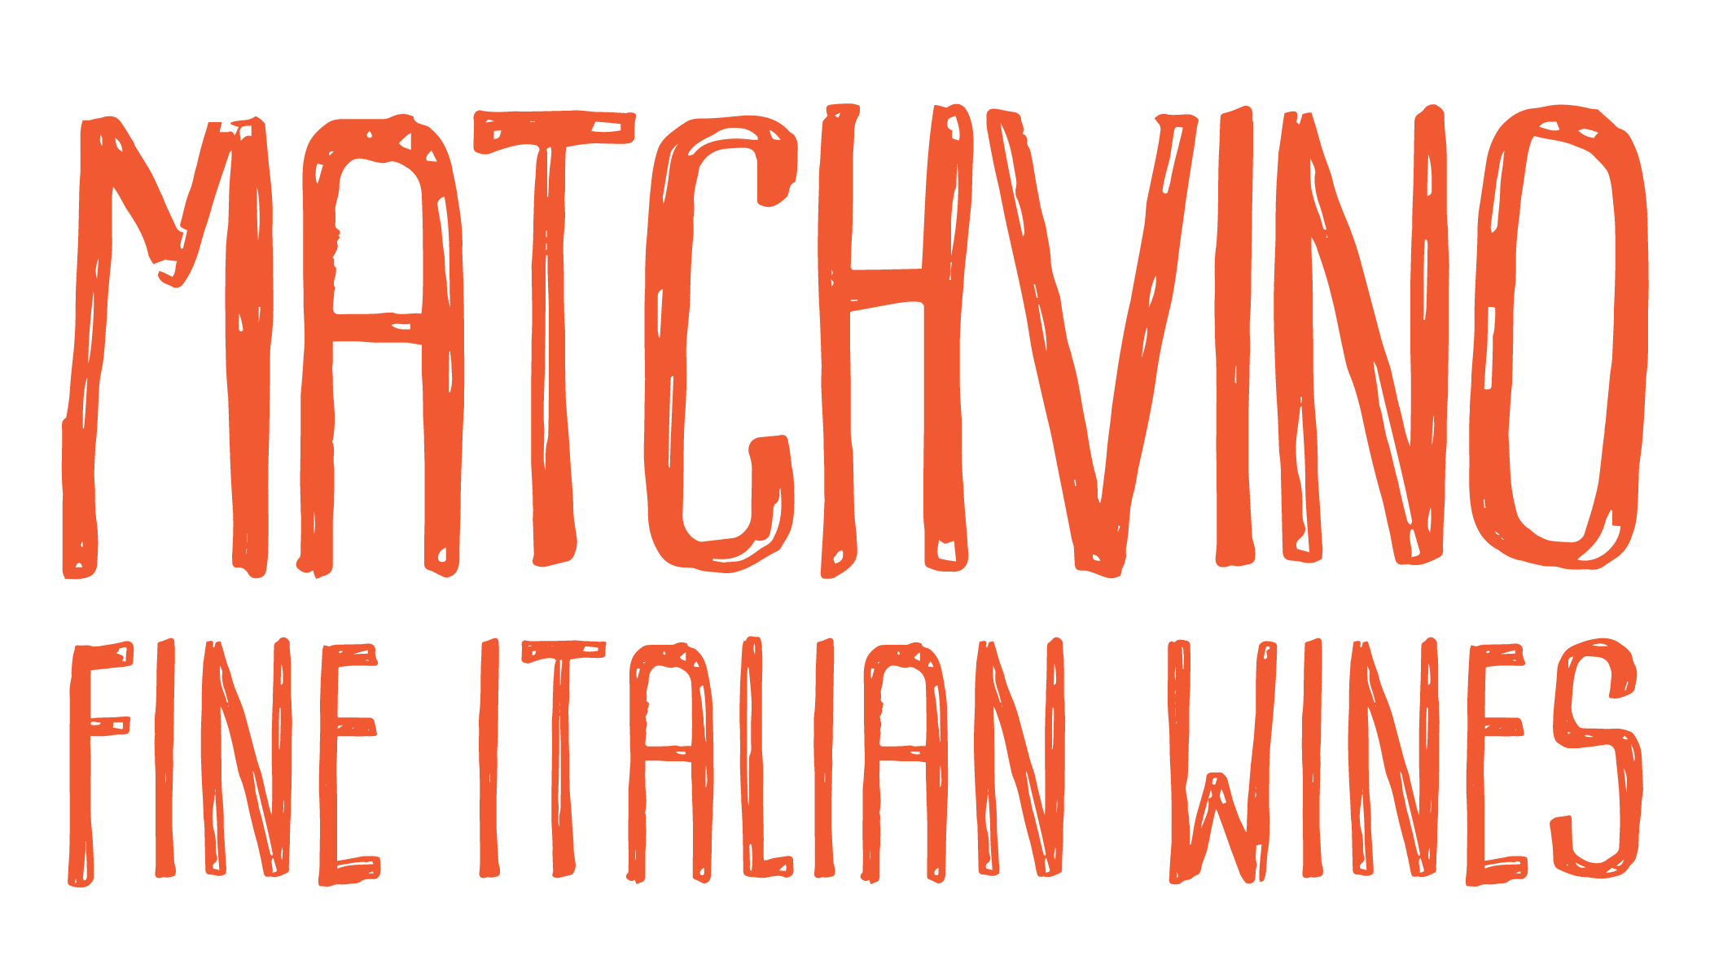
Molinetto
Piedmonte, Italy
Gavi DOCG
100% organically farmed cortese grapes
HEARTY MINERALS AT THE CORE
SUPPLE AND DELICATE w/ GOOD ACID AND MINERALS
APPLES, APRICOTS & ATTRACTIVE SALINITY
A CLASSIC FRESH
& EASY ITALIAN WHITE WINE
A
PAIRING: LIGHTER STYLE FARE,
OYSTERS, GRILLED VEGGIES,
SWARDFISH, CARPACCIO,
SEAFOOD SALAD.
Molinetto
Piedmonte, Italy
Gavi DOCG
100% organically farmed cortese grapes
HEARTY MINERALS AT THE CORE
SUPPLE AND DELICATE w/ GOOD ACID AND MINERALS
APPLES, APRICOTS & ATTRACTIVE SALINITY
A CLASSIC FRESH
& EASY ITALIAN WHITE WINE
A
PAIRING: LIGHTER STYLE FARE,
OYSTERS, GRILLED VEGGIES,
SWARDFISH, CARPACCIO,
SEAFOOD SALAD.
Molinetto
Piedmonte, Italy
Gavi DOCG
100% organically farmed cortese grapes
HEARTY MINERALS AT THE CORE
SUPPLE AND DELICATE w/ GOOD ACID AND MINERALS
APPLES, APRICOTS & ATTRACTIVE SALINITY
A CLASSIC FRESH
& EASY ITALIAN WHITE WINE
A
PAIRING: LIGHTER STYLE FARE,
OYSTERS, GRILLED VEGGIES,
SWARDFISH, CARPACCIO,
SEAFOOD SALAD.
Molinetto
Piedmonte, Italy
Gavi DOCG
100% organically farmed cortese grapes
HEARTY MINERALS AT THE CORE
SUPPLE AND DELICATE w/ GOOD ACID AND MINERALS
APPLES, APRICOTS & ATTRACTIVE SALINITY
A CLASSIC FRESH
& EASY ITALIAN WHITE WINE
A
PAIRING: LIGHTER STYLE FARE,
OYSTERS, GRILLED VEGGIES,
SWARDFISH, CARPACCIO,
SEAFOOD SALAD.

